Slide 1

2025-2026 Fall Semester Visual Programming Project
Spotiy
A comprehensive Windows music application showcasing modern database design and user experience principles

Slide 2

Introducing Spotiy: Your Complete Music Platform
Today, we're excited to present Spotiy, a feature-rich Windows music application developed by our team. This platform delivers a complete music streaming experience with powerful capabilities for all user types.
Core Features
User Experience: Stream music, create accounts, and manage favorite songs seamlessly
Artist Portal: Musicians can upload and manage their original content
Admin Control: Comprehensive user management including ban/unban functionality

Slide 3
Database Architecture: Entity-Relationship Design
Our application leverages MySQL for robust data management. The database architecture consists of five interconnected tables that handle user authentication, artist profiles, music content, and playlist management.
kullanicilar
Sanatcilar
muzikler
Primary Key: KullaniciID
Keys: SanatciID, KullaniciID
Keys: MuzikID, SanatciID
AdSoyad, Email, Sifre
OnayDurumu
SanatciAdi, SarkiAdi
Rol, Durum
SarkiSayisi
SarkiSozleri, Uzunluk
userPhoto
Biyografi
Tarih, UrlToken, Pictures
listeler
playlistmusic
Keys: ListeID, KullaniciID
Composite Keys: ListeID, KullaniciID, MuzikID
Ad, Gorunurluk
SiraNo
Next, let's examine the SQL implementation for each table to understand how data is structured and stored.

Slide 4
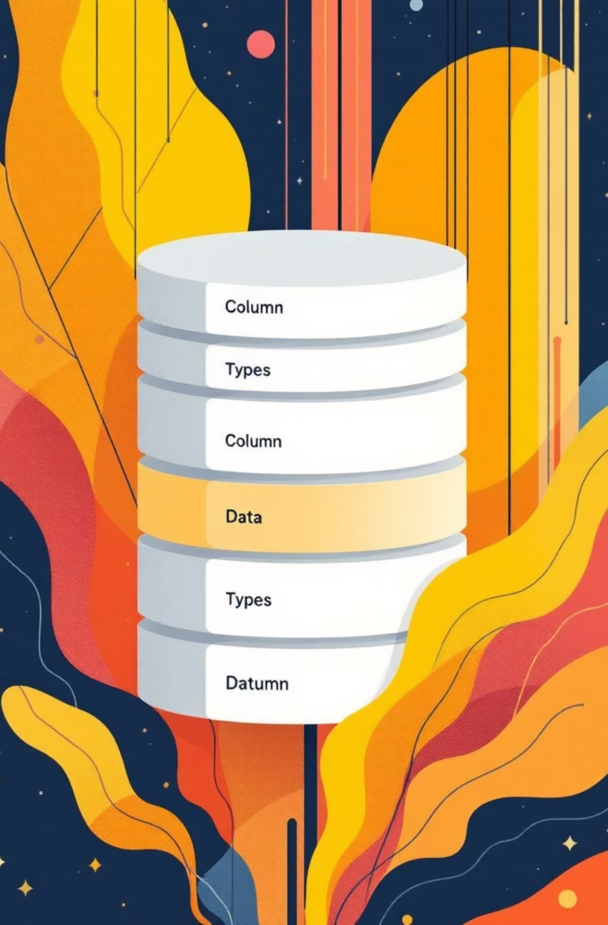
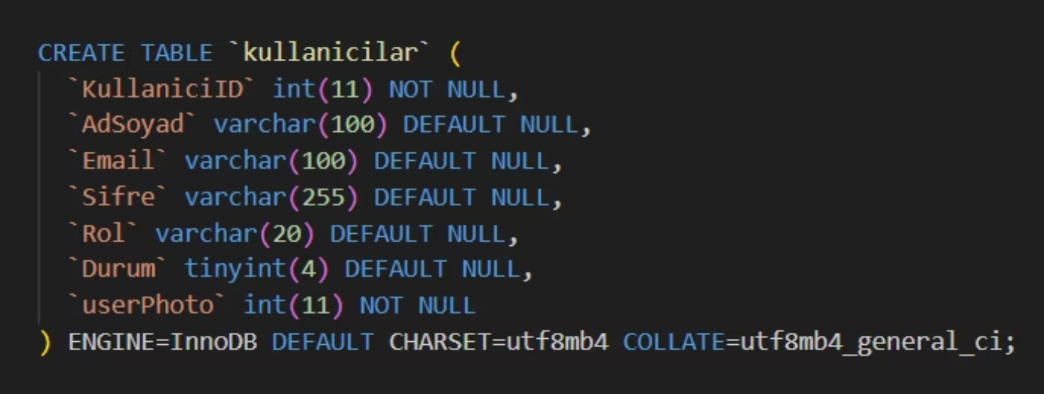
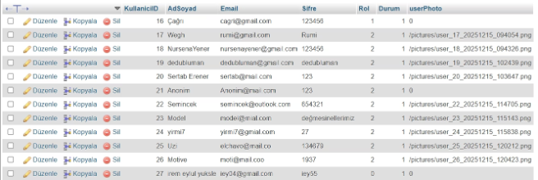
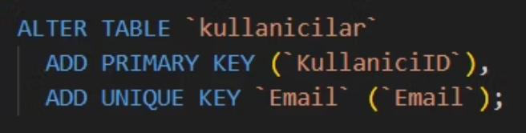
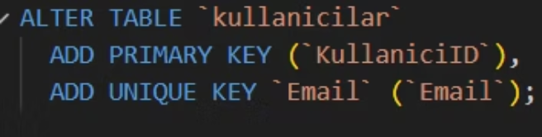
Kullanicilar Table: User Management Foundation
The kullanicilar (users) table serves as the core authentication and user profile management system. It stores essential user credentials, role assignments, and account status information.
Key Features
Auto-increment ID: Primary key generation
Unique Email: Prevents duplicate accounts
Role Management: User, Artist, Admin classifications
Status Control: Active/Banned state tracking

Slide 5
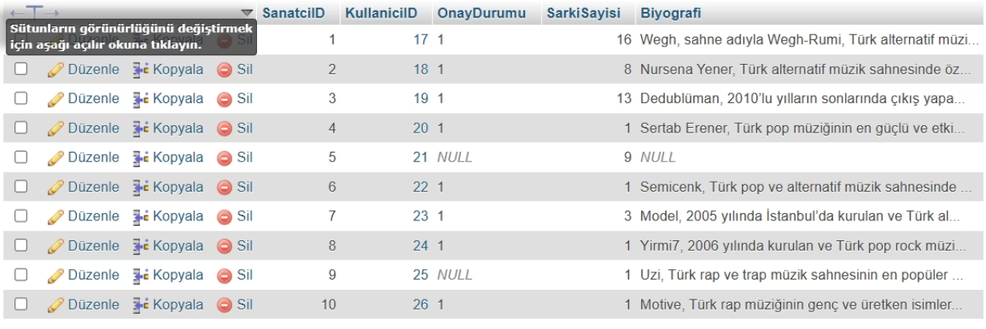
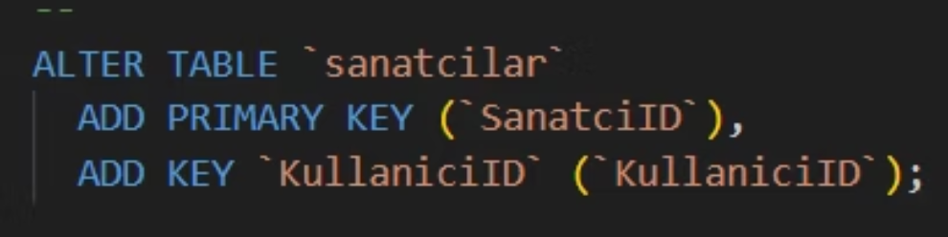
Sanatcilar Table: Artist Profile System
The Sanatcilar (artists) table extends user functionality for musicians. It maintains approval status, tracks uploaded content, and stores artist biographies—essential for content creators on the platform.
01
02
03
Foreign Key Relationship
Approval Workflow
Content Tracking
Links to kullanicilar table via KullaniciID for seamless user-artist association
OnayDurumu field manages artist verification and content moderation
SarkiSayisi automatically counts uploaded songs per artist

Slide 6
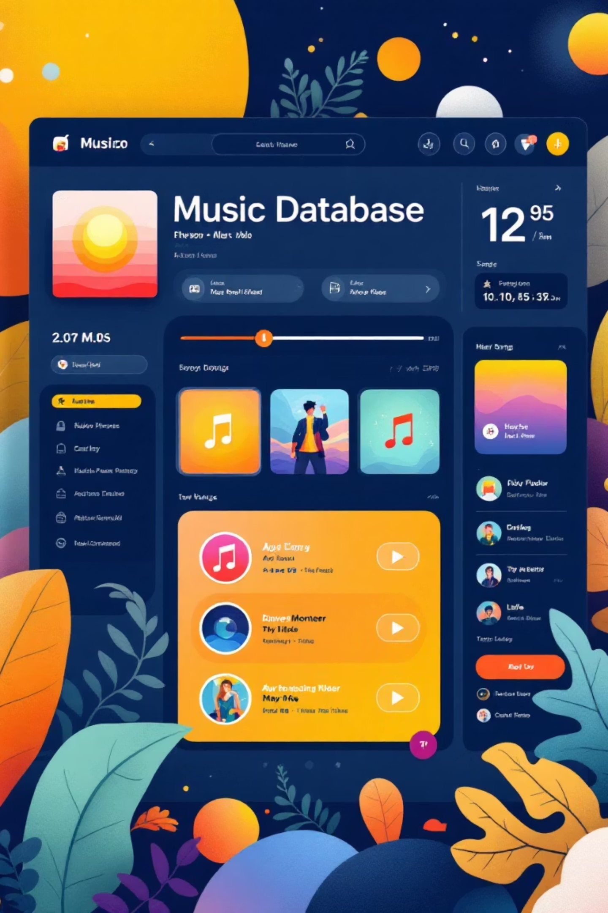
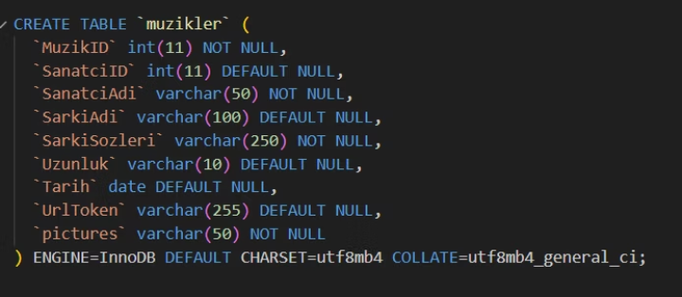
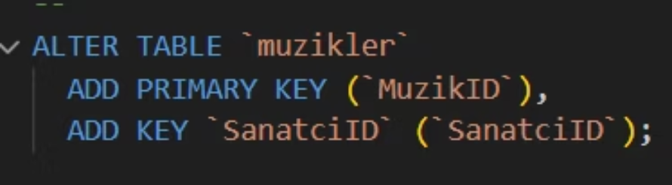
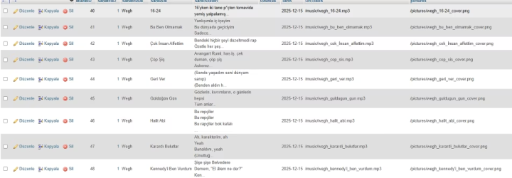
Muzikler Table: Music Content Repository
The muzikler (music) table is the heart of content storage, containing all song metadata, lyrics, audio file references, and associated artwork. Each record represents a unique track with comprehensive information.
Field Structure
MuzikID: Unique track identifier
SanatciID: Links to artist profile
Metadata: Artist name, song title, lyrics
Technical: Duration, upload date
Media: UrlToken for streaming, Pictures for album art

Slide 7

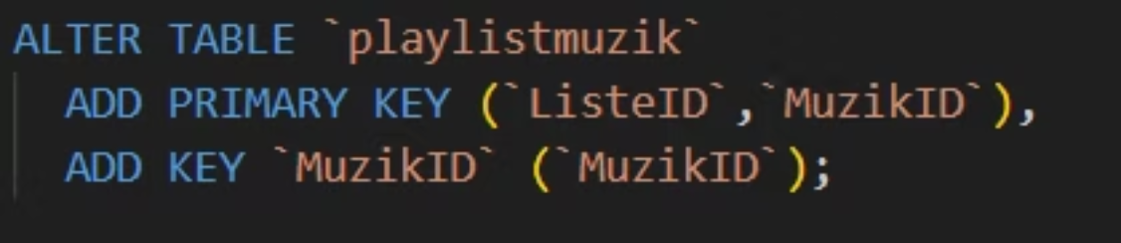


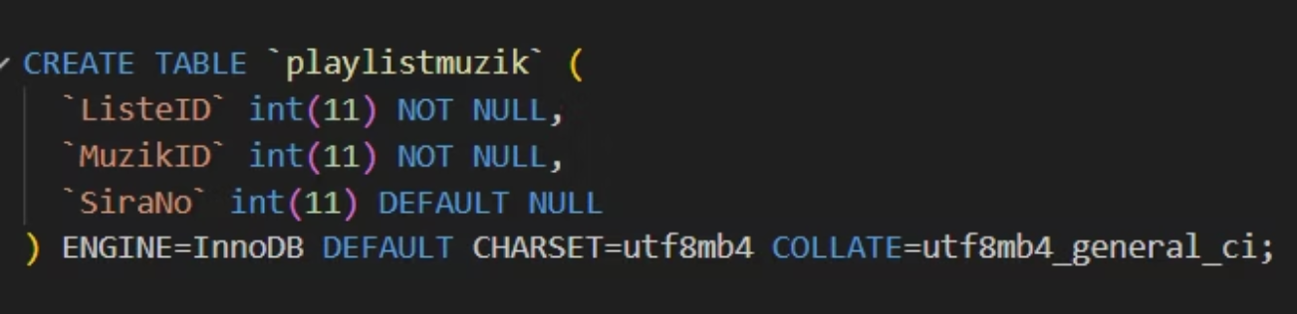
Playlistmusic Table: The Junction Solution
The playlistmusic table elegantly solves a many-to-many relationship challenge: one playlist contains multiple songs, and one song can appear in multiple playlists. This junction table bridges the gap.
Multiple Playlists
Each user can create unlimited playlists
Junction Bridge
Connects playlists with songs efficiently
Multiple Songs
Same song appears in different playlists
Critical Function
The SiraNo field maintains song order within each playlist, ensuring users' carefully curated sequences are preserved exactly as intended.

Slide 8
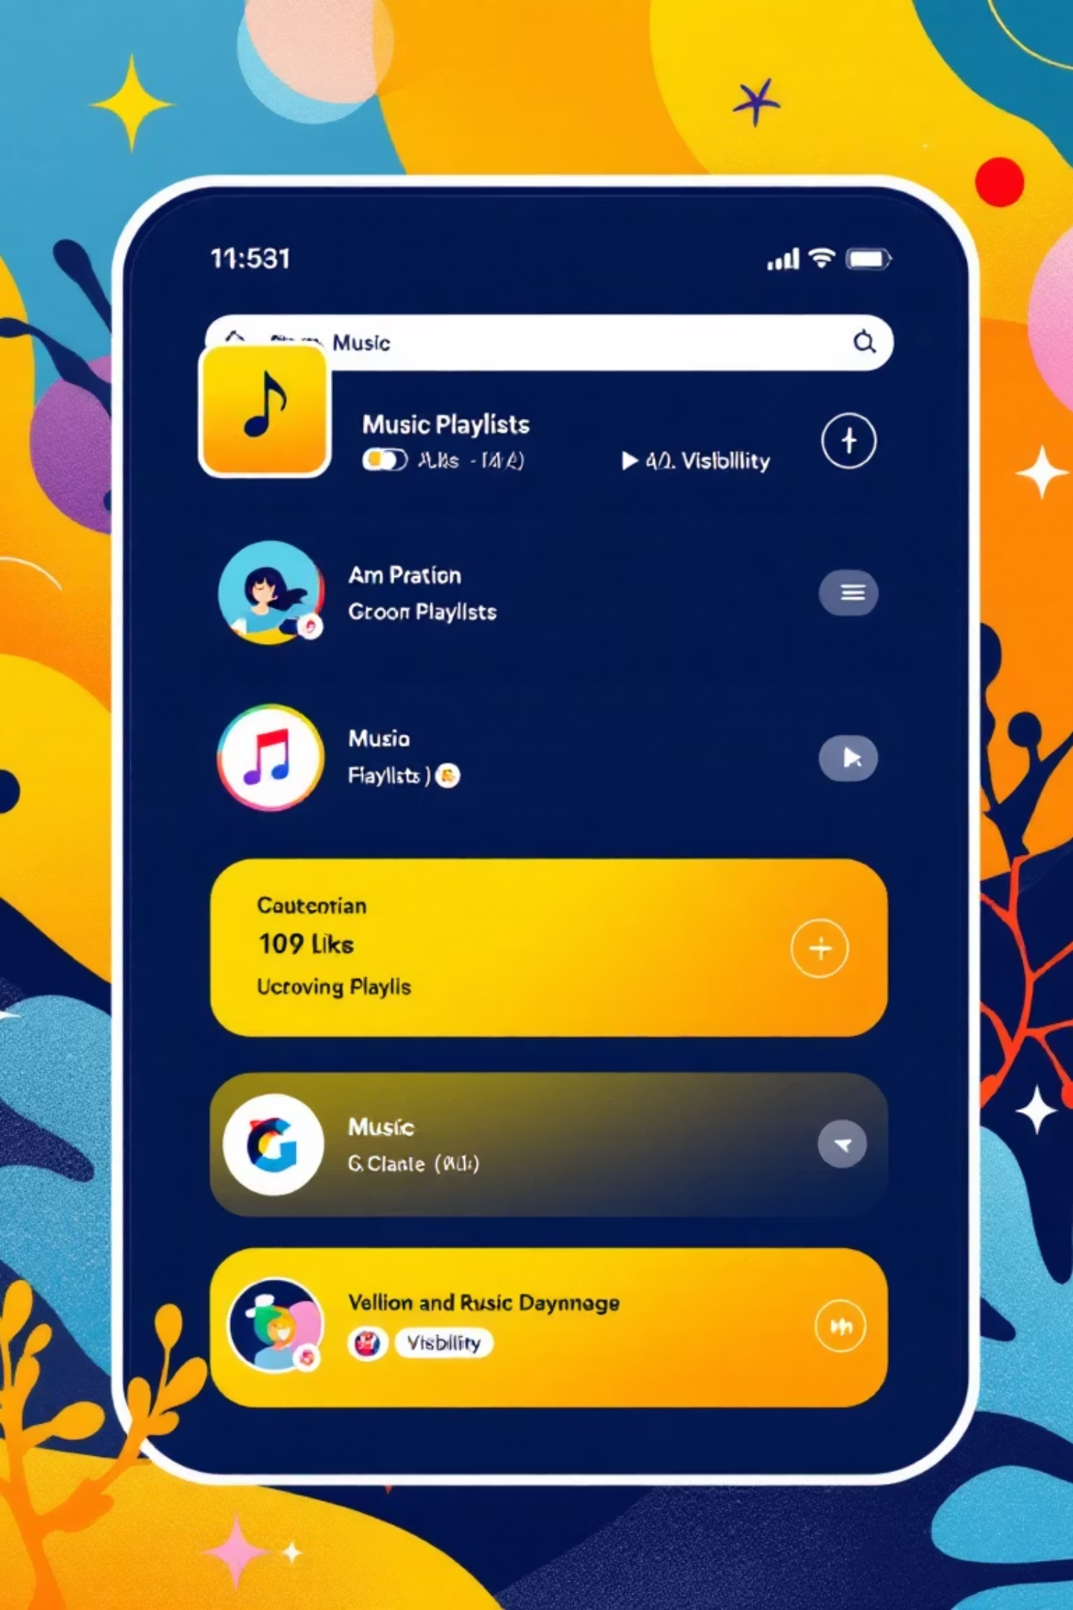

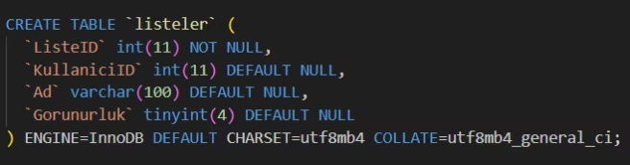
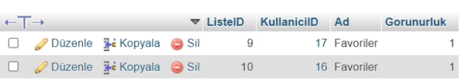
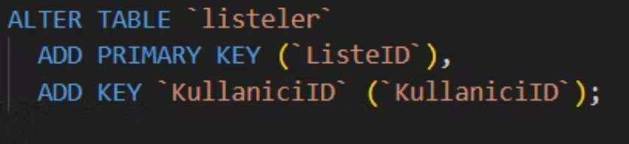
Listeler Table: Playlist Management
The listeler (playlists) table manages user-created collections. It tracks ownership, naming, and privacy settings, enabling both personal libraries and public sharing capabilities.
ListeID
Primary key identifier
KullaniciID
Owner reference
Ad
Playlist name
Gorunurluk
Privacy control

Slide 9


From Database to Interface
Data Foundation
Five interconnected MySQL tables managing users, artists, music, playlists, and relationships
Backend Logic
SQL queries and business logic connecting database operations to application features
Windows Interface
Visual Programming techniques bring data to life through intuitive user experience
Ready for the demo? Our database architecture is complete and functional. Now let's explore how users interact with Spotiy through the Windows application interface.

Slide 10
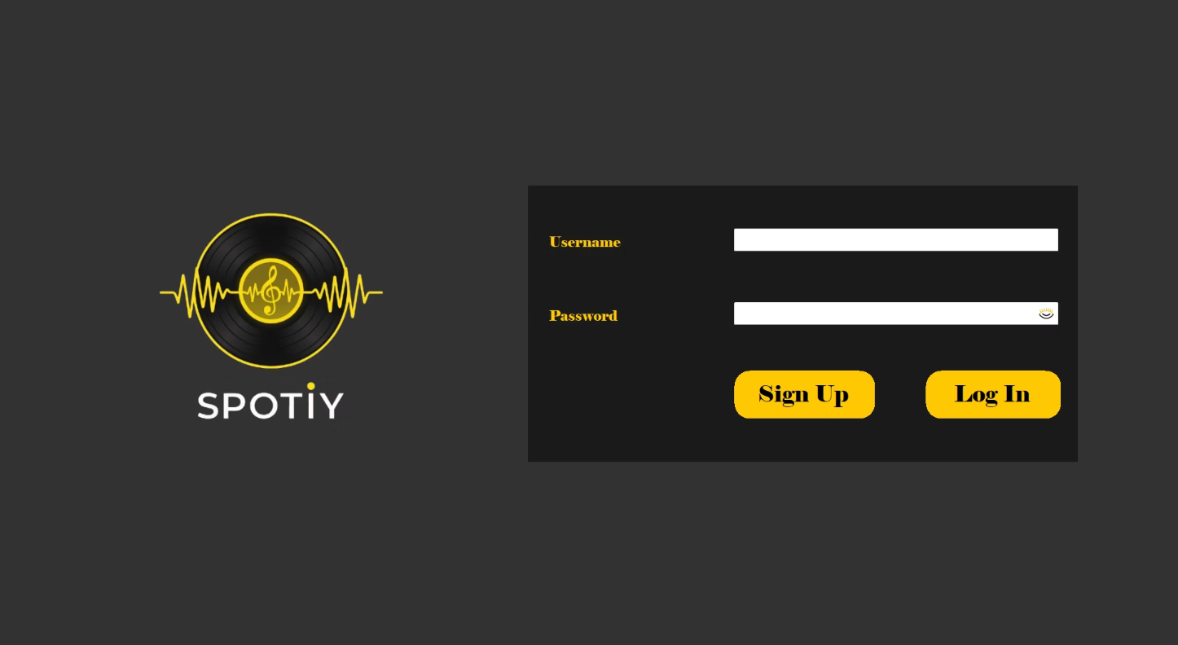
Entry Page: First Impressions Matter
Clean & Functional Design
The entry page welcomes users with a minimalist, purposeful layout that prioritizes usability and brand identity.
UI Components
Brand logo establishing visual identity
Two descriptive labels guiding user input
Username & password fields for authentication
Login and Register buttons for account access
Eye icon toggle for secure password visibility control
This straightforward interface ensures users can quickly access their accounts or create new ones without friction.

Slide 11

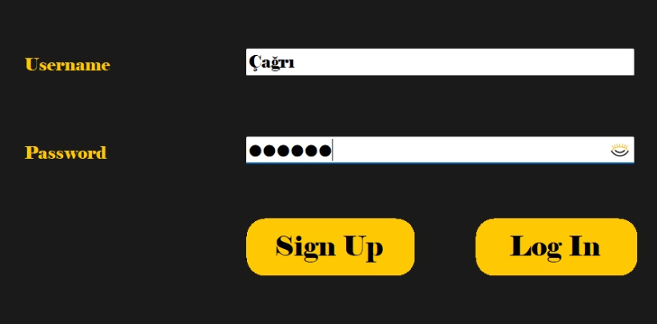
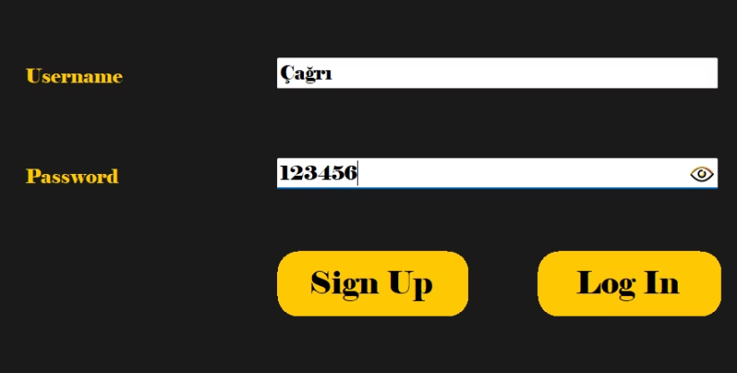
Password Visibility Toggle
Understanding the eye icon interaction pattern for secure password entry in modern user interfaces.
Hidden State
Visible State
By default, the eye icon appears closed, indicating that the password is masked with dots or asterisks for security.
When clicked, the eye icon opens and reveals the password in plain text, allowing users to verify their entry before submission.
This toggle interaction improves user experience by reducing password entry errors while maintaining security through intentional user action.

Slide 12
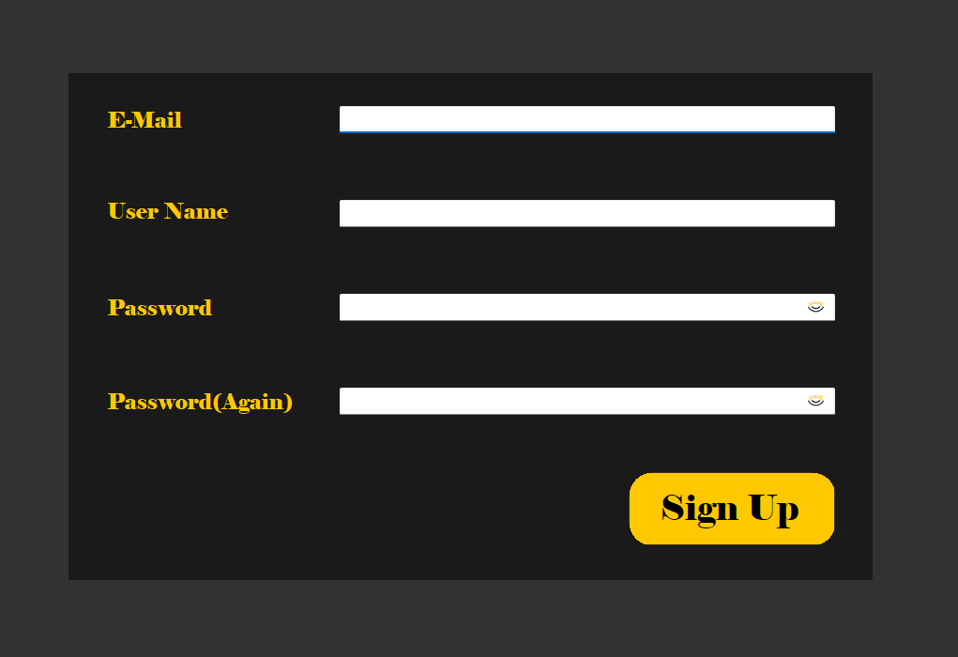
User Registration Interface
01
02
Account Creation
Password Security
New users begin by entering their email address and choosing a unique username for their account identity.
Password must be entered twice for confirmation, preventing typos. Eye icons enable visibility toggling for accuracy.
03
Registration Complete
After all required fields are validated, users click the Sign Up button to finalize account creation and access the platform.

Slide 13
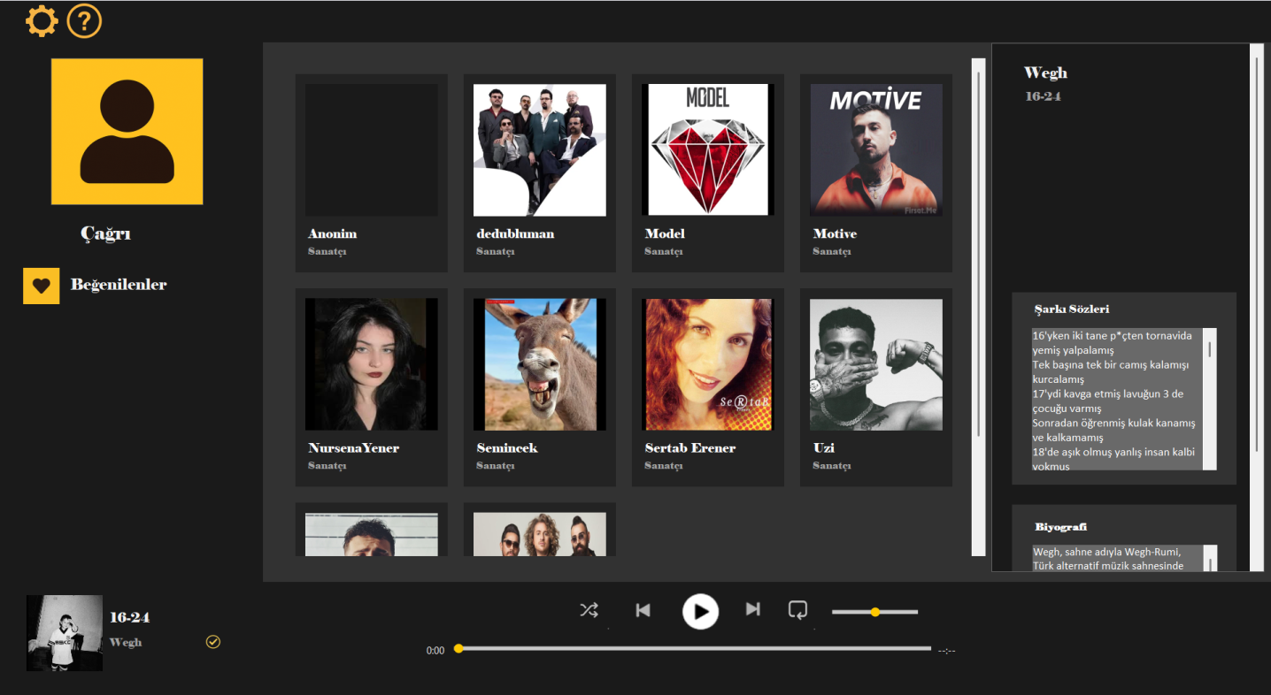
Main Application Dashboard
1
User Profile Sidebar
The left panel displays user information and provides quick access to favorite songs for personalized navigation.
2
Artist Grid Display
The center section features a responsive grid layout showcasing artists, enabling intuitive browsing and selection.
3
Content Details Panel
The right side presents detailed information including song lyrics and artist biographies when content is selected.
4
Playback Controls
A persistent bottom bar includes play, pause, next, previous, shuffle, repeat, and volume controls for seamless music management.
This three-panel layout provides a comprehensive and user-friendly music listening experience with all essential features accessible in a single view.

Slide 14
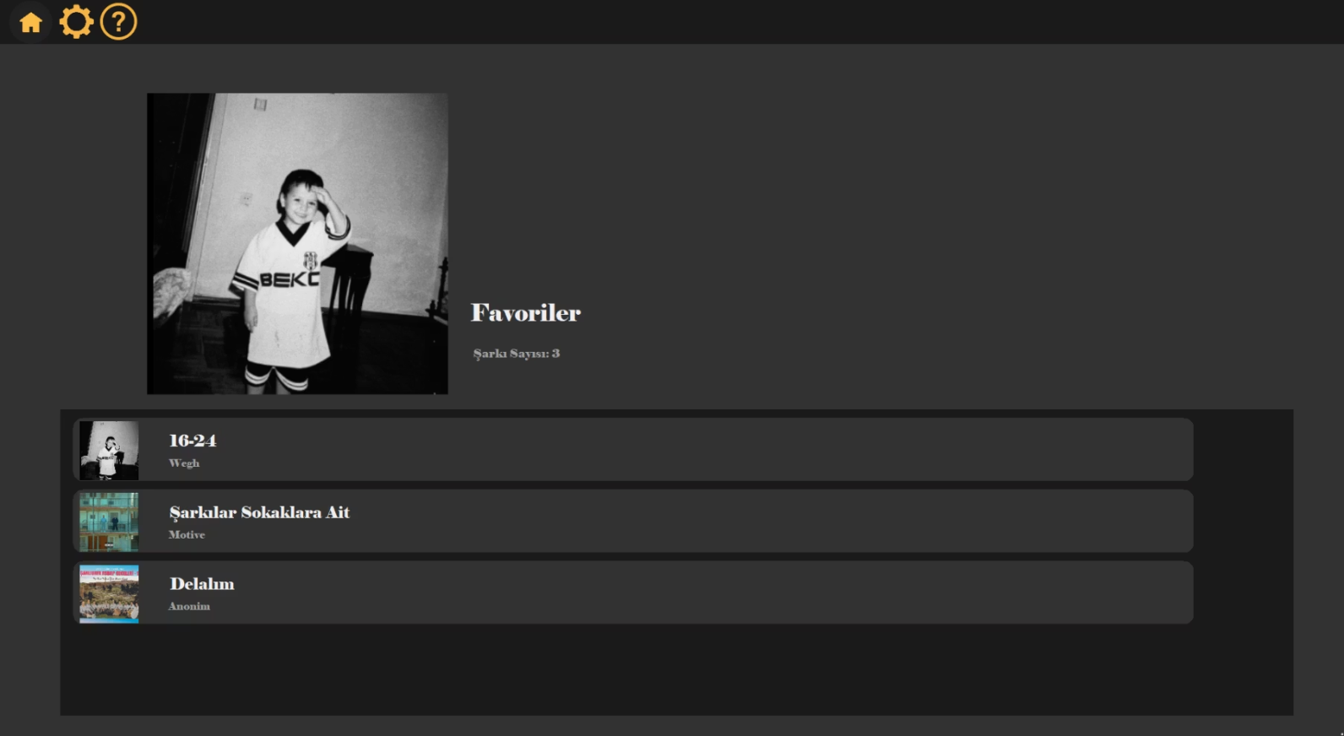
Favorites Collection
Personal Music Library
The Favorites page serves as a curated collection where users can manage and access their most loved tracks.
Total favorite count displayed prominently
Songs organized in an ordered, scannable list
Direct playback from any track in the collection
Integration with bottom music player controls
This dedicated favorites feature enables instant access to frequently played songs, improving user engagement and listening convenience.

Slide 15
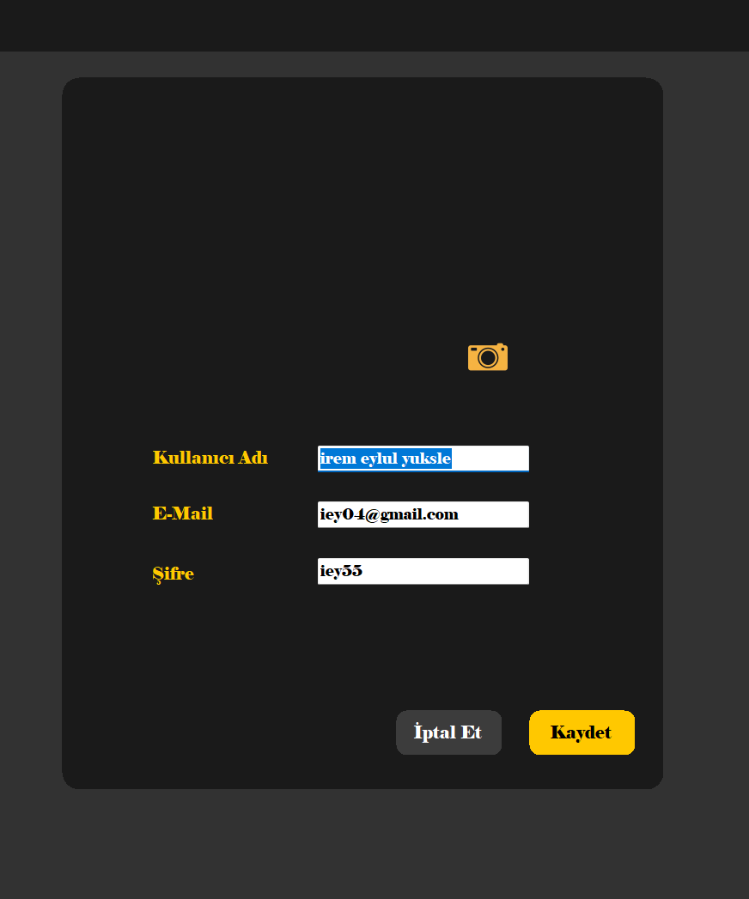
Profile Settings Management
Personal Information
Profile Picture
Users can view and modify their username, email address, and password through an intuitive form interface.
The camera icon enables users to upload and update their profile image, personalizing their account appearance.
Save or Cancel
Changes are committed to the database with the Save button, while Cancel discards modifications without updating.

Slide 16
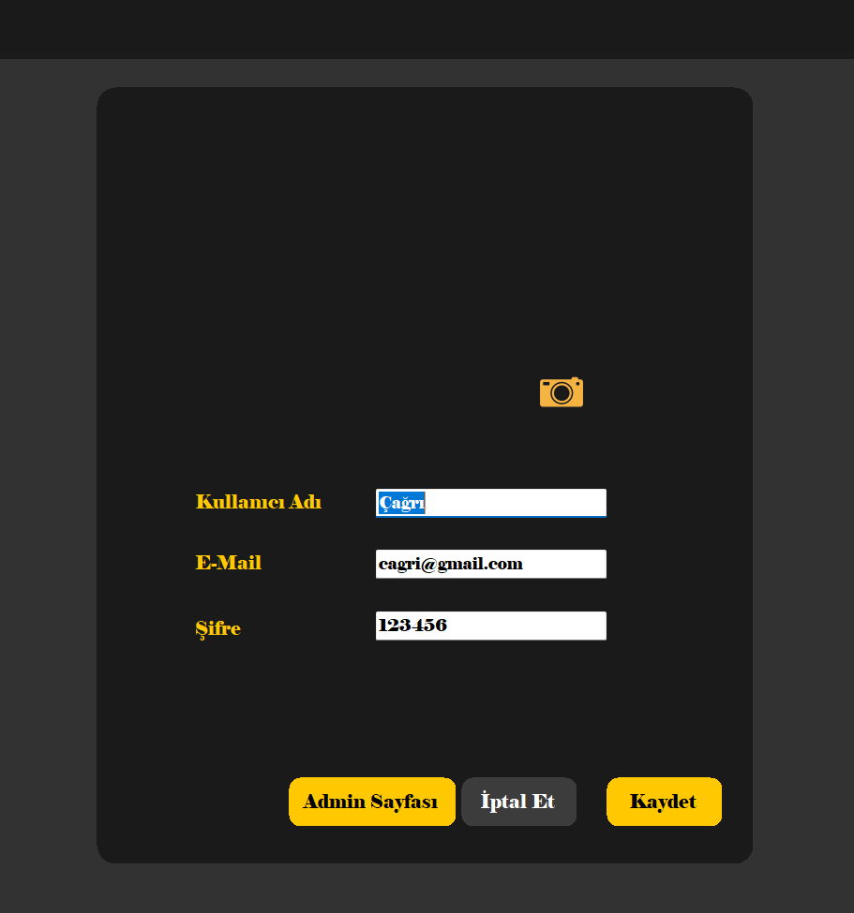

Enhanced Profile Configuration
Standard Controls
Photo Management
Update username, email, and password fields with real-time validation.
Camera icon triggers image upload for profile customization.
Admin Access
Privileged users see direct navigation to administrative panel.
Role-Based Features: The interface adapts based on user permissions, showing additional controls for administrators while maintaining security boundaries.
This settings page implements role-based access control, ensuring appropriate functionality is available to each user type while maintaining consistent design patterns.

Slide 17
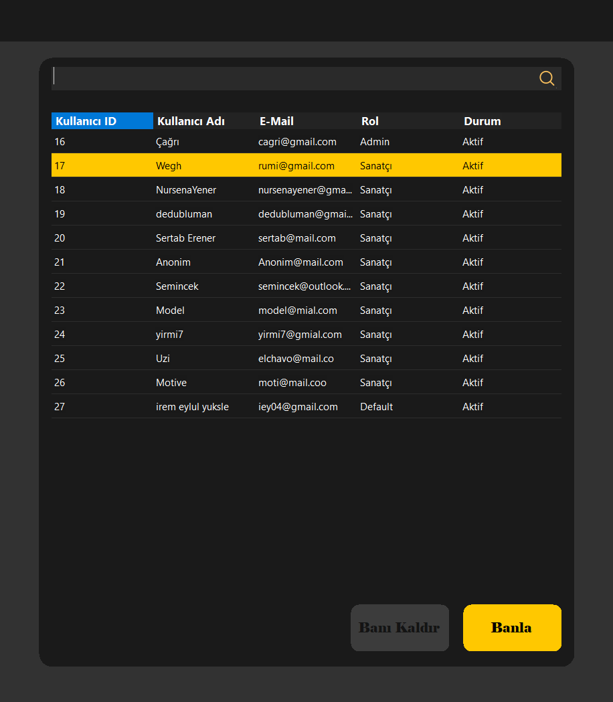



Administrative Control Panel
User Discovery
Search functionality and comprehensive table display of all registered accounts.
Account Selection
View user details including ID, username, email, role, and current status.
Access Control
Ban and Unban buttons enable administrators to manage account permissions.
The admin panel provides centralized user management, ensuring secure and controlled access throughout the system with audit-ready account tracking.

Slide 18
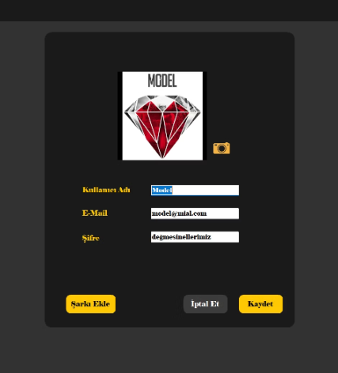
Artist Profile Dashboard
Artist-Specific Features
Artists access enhanced profile controls tailored to content creators:
Standard profile editing (username, email, password)
Profile image management via camera icon
Add Song button for direct upload access
Save/Cancel options for database transactions
This specialized interface empowers artists with streamlined content creation tools alongside standard account management capabilities.

Slide 19
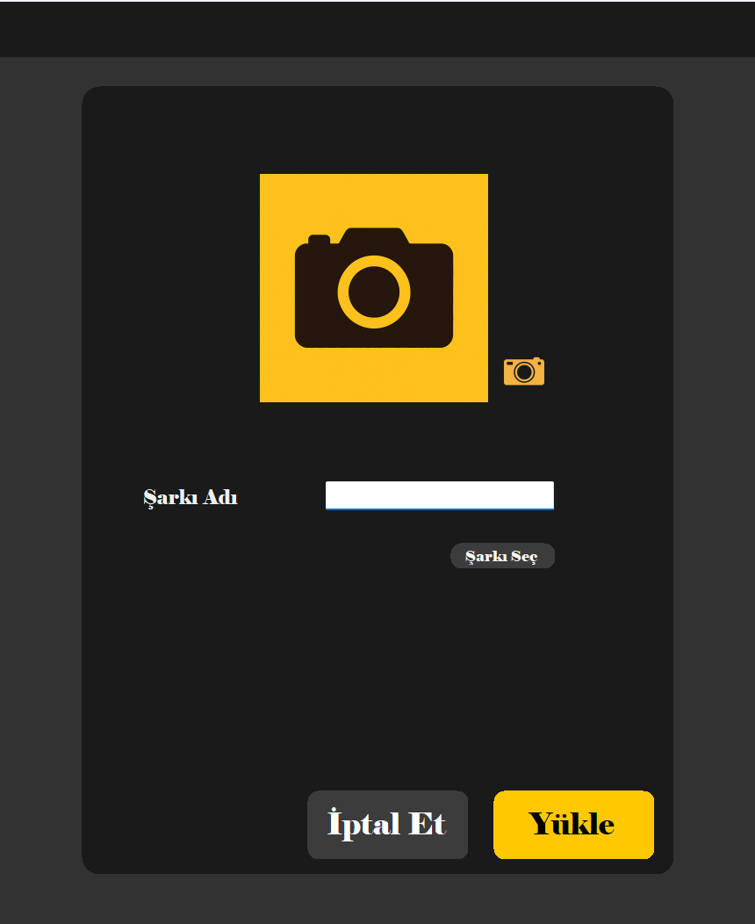
Song Upload System
1
Access Control
Only verified artist accounts can reach the upload interface, maintaining content quality standards.
2
Metadata Entry
Artists input song title and select cover artwork from their local file system.
3
Audio Selection
Choose and attach the audio file to be uploaded to the platform database.
4
Publication
Upload button processes and stores the complete song package, making it immediately available.
This role-restricted upload system ensures only authorized artists can contribute content while maintaining a straightforward submission workflow.

Slide 20
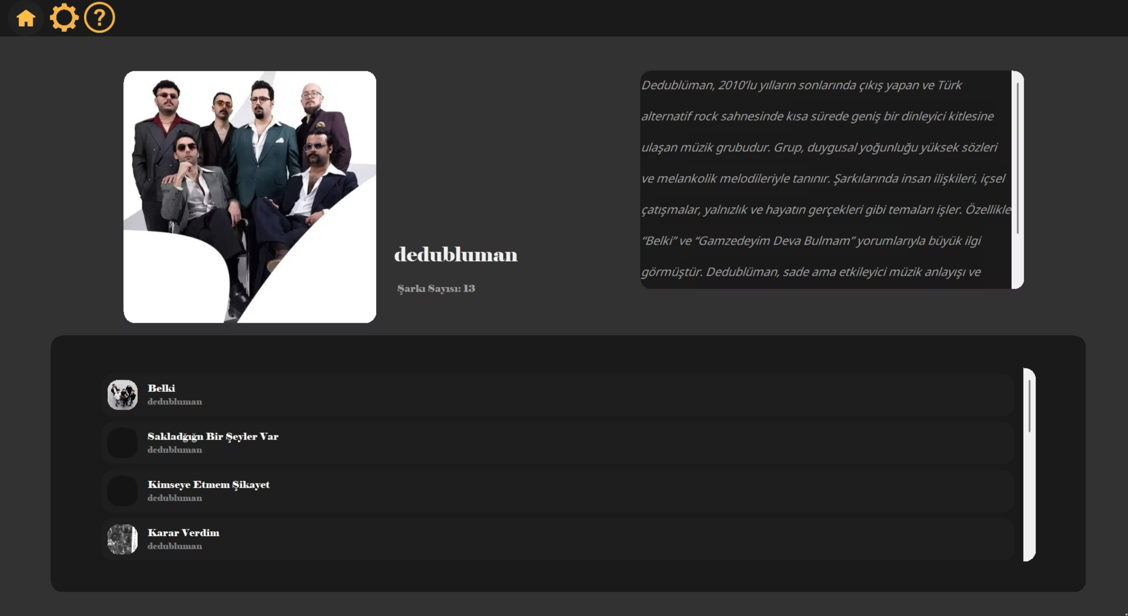
Artist Detail View
This comprehensive artist page consolidates profile information, biography, and complete catalog in a unified, explorable interface that enhances music discovery and artist engagement.

Slide 21
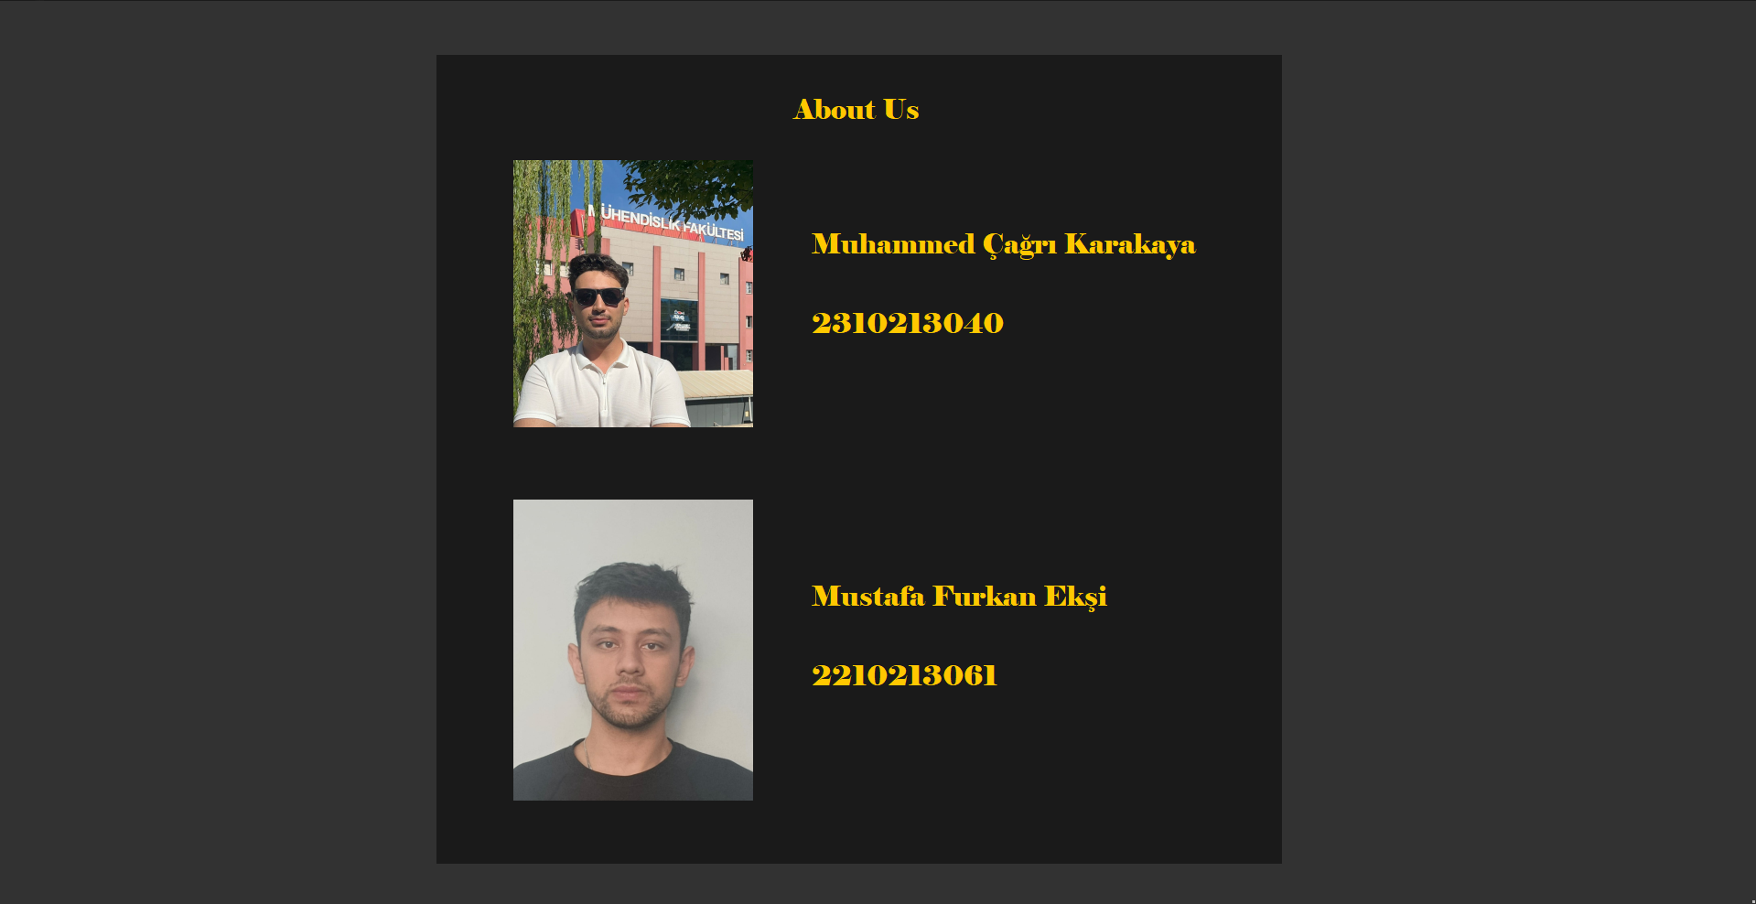
About Us
This is the About Us page of our application. On this screen, we introduce the developers of the Spotiy project. It displays the names, student numbers, and photos of the team members. This page provides information about who developed the application and adds transparency and identity to the project.

